Slide 1
the customers total payment spend (over 150 $)
<visualization>
this query shows the sum of customer total spend in condition that the spending over 150 $ group by the customer id , I did the join between 2 tables the customer and the payment and for the aggregation I used the sum operator and Eleanor is a good customer along with Kari !

Slide 2
What are the most popular category in movies ?
<visualization>
I made this query to figure out what is the most common category and according to my results it is the sports ! I didn’t expect this result , I was expecting something like horror or action to be in the first place but I was wrong

Slide 3
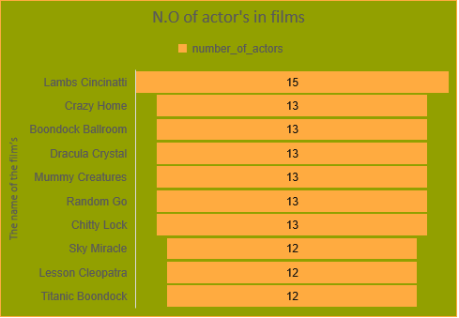
What are the 10 films with the largest number of actor?
<visualization>
This query shows the most number of actor’s in a movie , I had to join 3 tables in nested query , the result shows that the “ Lambs Cincinatti” had the largest number of actors in a single movie with 15 actors , and from the 2nd to the 7th place we have 13 actors , and the last 3 of the 10 has 12 actors in a single movie

Slide 4
the average amount of Lambs Cincinatti film after each payment process?
<visualization>
“ Lambs Cincinatti” is the film with the largest number of actors , so I figured to investigate with the payment side , I retrieved the average amount after each payment process , in 20/3/2007 the amount was normal comparing to the average but in the next month for the same year there was decreasing for amount it was less than the average , but if we think about it , this is normal for every movie in the field !

